Slide 1



EV Vehicle/Charging Demand Prediction
PRESENTED BY
Student Name : Suryansh Dhama
AICTE Student ID:
STU67e697b2203411743165362
AICTE Internship ID:
INTERNSHIP_1748923002683e727a876ea

Slide 2

Learning Objectives:
Explore and analyze real-world EV adoption data from Washington state.
Clean and preprocess the dataset for time-series forecasting.
Engineer features like EV growth rate, lags, and cumulative counts.
Train and apply a machine learning model to forecast EV demand.
Visualize trends through interactive graphs and comparative analysis.
Build and deploy a user-friendly forecasting tool using Streamlit.
GOAL
Source :

Slide 3
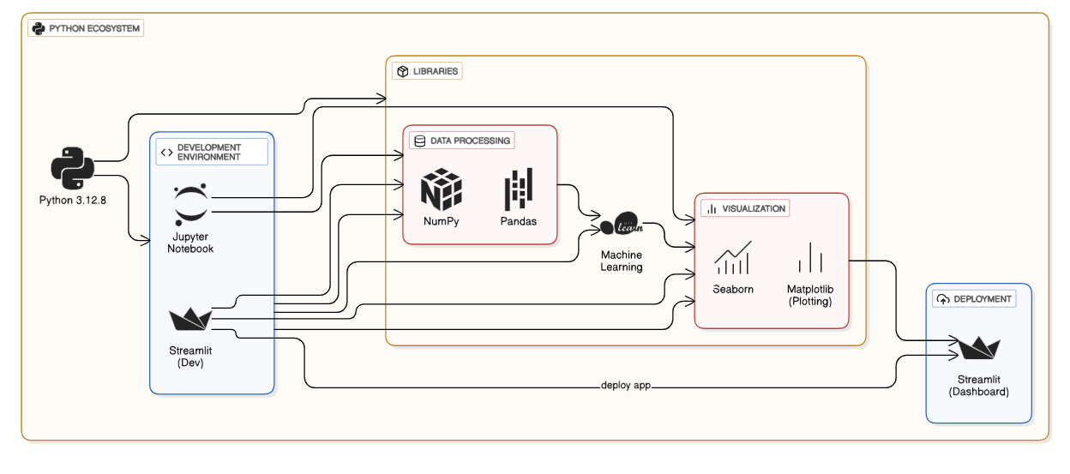
Tools and Technology used

Slide 4
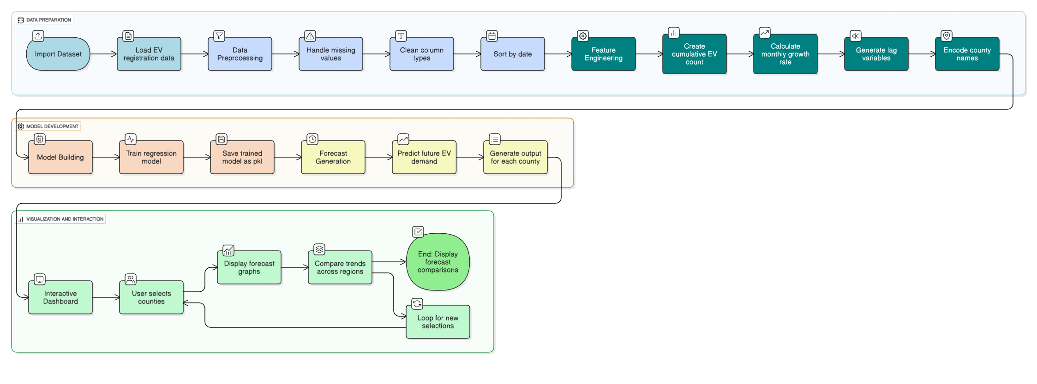
Methodology

Slide 5
Problem Statement:
The Washington State government has EV population data for 270 counties, but lacks predictive insight into future demand.
Planning EV charging infrastructure without demand forecasting leads to under- or over-investment.
Existing datasets are underutilized due to the absence of AI/ML-based forecasting tools.
County-wise EV growth trends are not easily comparable or visualized using manual methods.
There is no real-time system that allows interactive analysis or future planning based on historical EV trends.
Sustainable infrastructure development needs smart tools to predict where and when EV growth will occur.
Existing EV data is used only for analysis of the past, not for predicting future trends.

Slide 6
Solution:
Developed a forecasting system to predict EV growth for each county in Washington State using historical data.
Used machine learning regression models such as Random Forest, Decision Tree, and Support Vector Regressor (SVR) to estimate future EV adoption.
Performed county-wise analysis to understand regional EV penetration and future growth potential.
Trained the model using historical EV registration data and forecasted EV demand for the next 36 months.
Engineered features like lag values, growth rate, cumulative totals, and encoded county identifiers to improve prediction accuracy.
Evaluated model performance using metrics like R² Score, RMSE, and MAE for accurate forecasting.
Built and deployed an interactive Streamlit app to visualize and compare EV forecasts across counties.
GitHub Repository
GitHub Profile

Slide 7
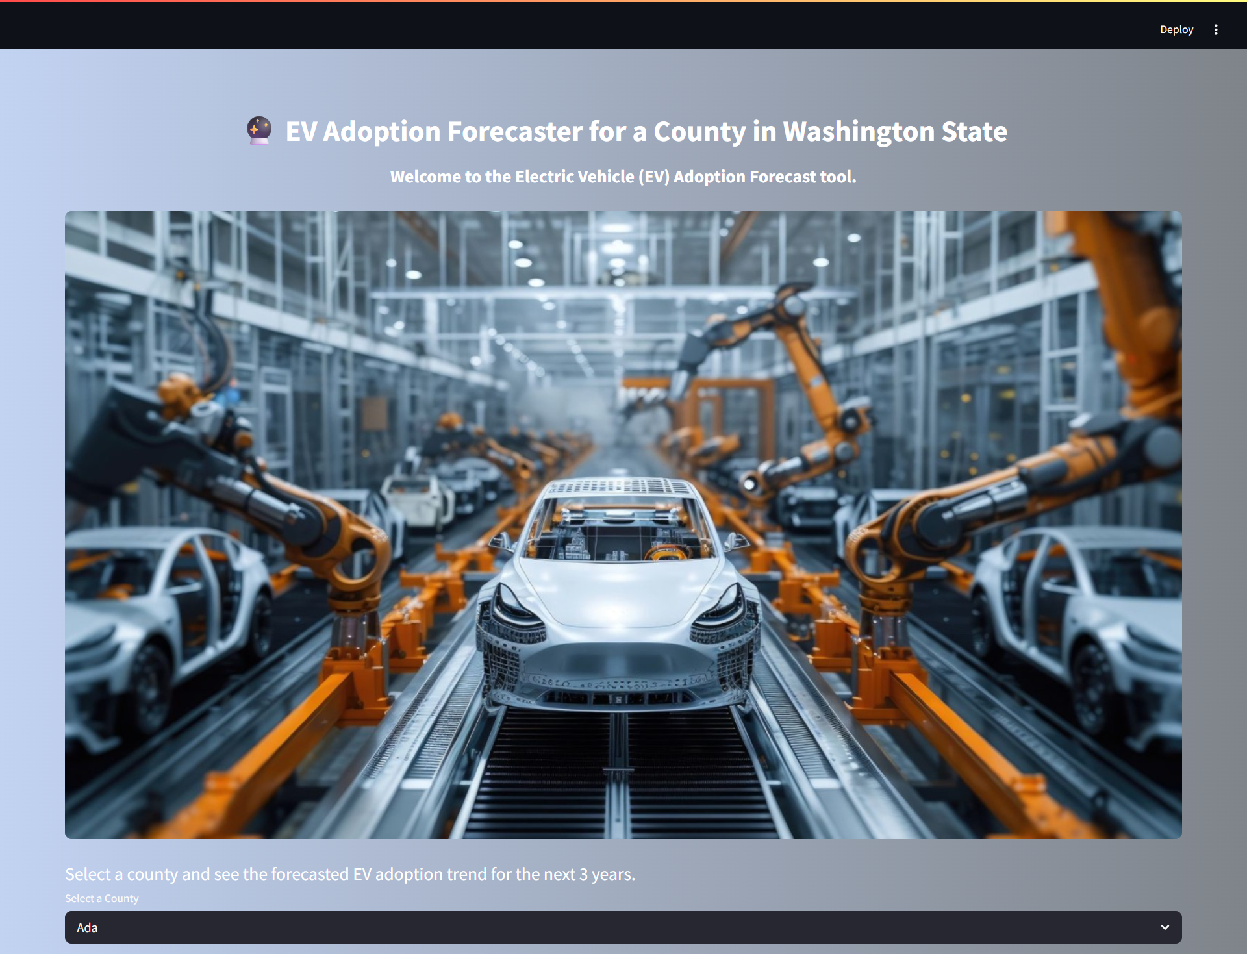
Screenshot of Output:

Slide 8
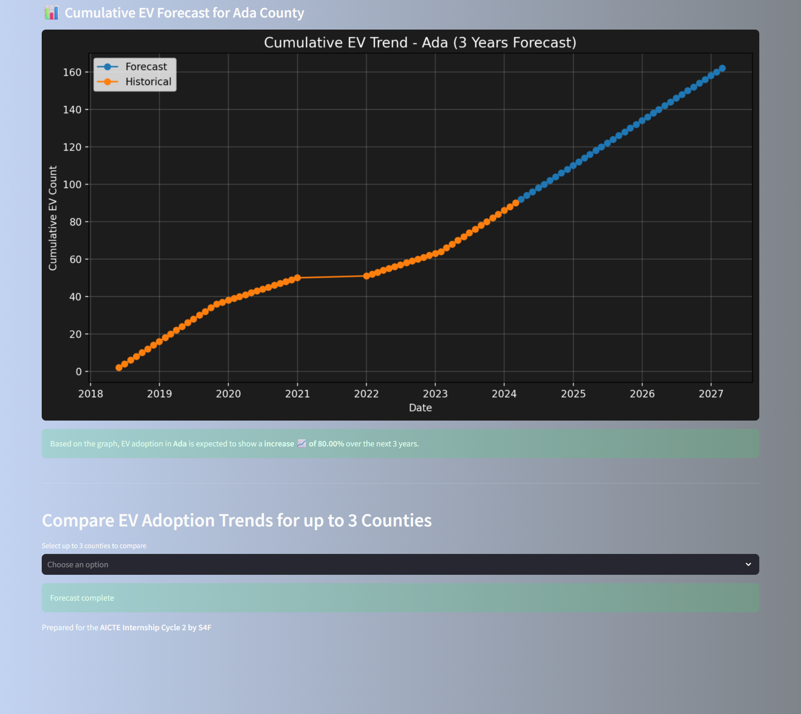
Screenshot of Output:

Slide 9
Conclusion:
Project Summary:
Identified a real-world challenge in forecasting electric vehicle (EV) demand across ~270 counties in Washington State, which is crucial for sustainable infrastructure planning.
Processed and analyzed historical EV population data, engineered relevant features like lag values, growth rate, and cumulative counts, and built a machine learning pipeline to generate 36-month forecasts.
Trained and evaluated multiple regression models (Linear Regression, Decision Tree, Random Forest), selecting the one with best performance metrics like RMSE and R².
Developed a full-featured interactive dashboard using Streamlit, allowing users to select counties and compare forecasted EV growth visually.
Future Scope:
Experiment with advanced models like SVR (Support Vector Regression) or XGBoost to improve accuracy and handle nonlinear growth patterns more effectively.
Integrate real-time data streams and map-based visualization for dynamic updates, allowing stakeholders to make real-time planning decisions across regions.

